Slide 1

Investigations of distributional shifts and trends in the repeated and infinite spatial prisoner's dilemma
Robin Staab, Kim Nik Baumgartner, Fabrice Egger, Jan Urech, Nando Käslin

Slide 2
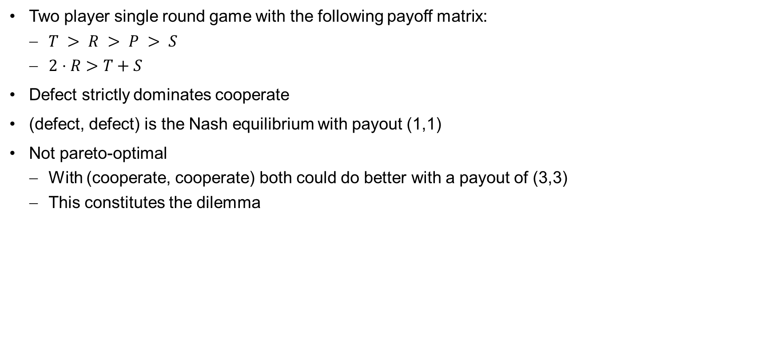
Introduction – Prisoner‘s Dilemma
cooperate
defect
(R,R)
(S,T)
cooperate
Two player single round game with the following payoff matrix:
$T > R > P > S$
$2⋅R>T+S$
Defect strictly dominates cooperate
(defect, defect) is the Nash equilibrium with payout (1,1)
Not pareto-optimal
With (cooperate, cooperate) both could do better with a payout of (3,3)
This constitutes the dilemma
(T,S)
(P,P)
defect
Nash equilibrium
cooperate
defect
cooperate
(3,3)
(0,5)
defect
(5,0)
(1,1)
Nash equilibrium

Slide 3
Introduction – Repeated Prisoner‘s Dilemma (RPD)
Players play the prisoner‘s dilemma repeatedly against each other.
Each player is interested in maximizing his total payout.
Each player can react to opponents' choices.
Selection of possible strategies:
Random: play randomly cooperate or defect
Always cooperate
Always defect
Tit-for-tat (TFT): copy opponent's last move
Grim trigger (GT): start defecting as soon as opponent defects once and never stop defecting
Tit-for-tat defect (TFTD): This strategy starts with D and, in the subsequent rounds, copies the opponent's last move.
Tit-for-two-tats (TF2T): This strategy starts with C in rounds 1 and 2 and plays D only if the opponent played D the last two moves
Related Work
The Evolution of Cooperation [Axelrod, 1981]
Cooperation under the Shadow of the Future: Experimental Evidence from Infinitely Repeated Games [Bó, 2005]
Morality Metrics On Iterated Prisoner's Dilemma Players [Singer, 2014]

Slide 4
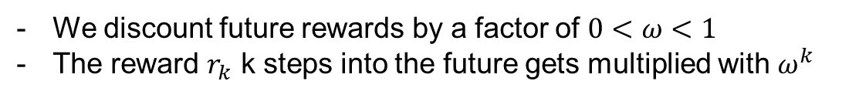
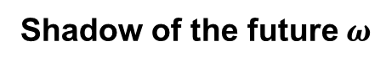
Introduction – Infinite Prisoner‘s Dilemma (IPD)
Natural extension to the Repeated Prisoner’s Dilemma
“Simulates” an infinite amount of rounds
As sum of payoffs generally does not converge:
We can explicitly compute the expected payoff of two strategies in such a game (see Appendix A)
Related Work
Cooperation in the Infinitely Repeated Prisoners′ Dilemma with Perturbations [Watson, 1994]
Cooperation under the Shadow of the Future: Experimental Evidence from Infinitely Repeated Games [Bó, 2005]
Shadow of the future $ω$
We discount future rewards by a factor of $0<ω<1$
The reward $r_{k}$ k steps into the future gets multiplied with $ω^{k}$

Slide 5
Introduction – Spatial Prisoner‘s Dilemma
Players play the prisoner‘s dilemma repeatingly against each other on a two-dimensional, discrete map.
Each player is interested in maximizing his total payout.
Each player can react to opponents' choices.
Migration and Imitation are possible.
Several works also deal with evolutionary strategies that develop new behaviors through a survival-of-the-fittest selection process
Our simulations however build on the Imitate-and-Migrate paradigm
Related Work
Evolutionary Games and Spatial Chaos [Nowak, 1992]
A Spatial Iterated Prisoners Dilemma Game Simulation With Movement [Majeski, 1997]
Evolutionary Analysis on Spatial Locality in n-Person Iterated Prisoner‘s Dilemma [Suzuki, 2003]
Spatial Strategies in a Generalized Spatial Prisoner’s Dilemma [Ishida, 2005]
Spatial Order Prevails Over Memory in Boosting Cooperation in the Iterated Prisoner’s Dilemma [Alonso-Sanz, 2009]

Slide 6
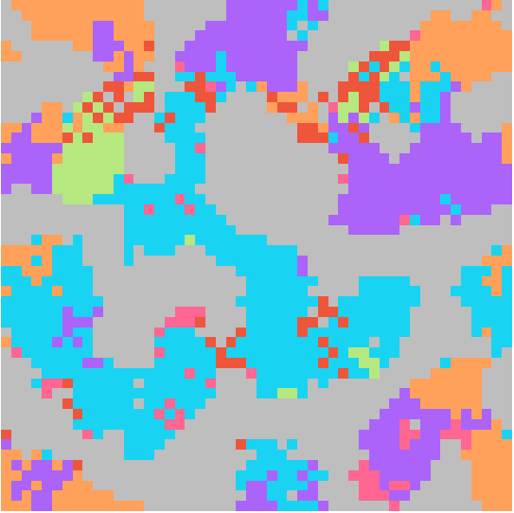
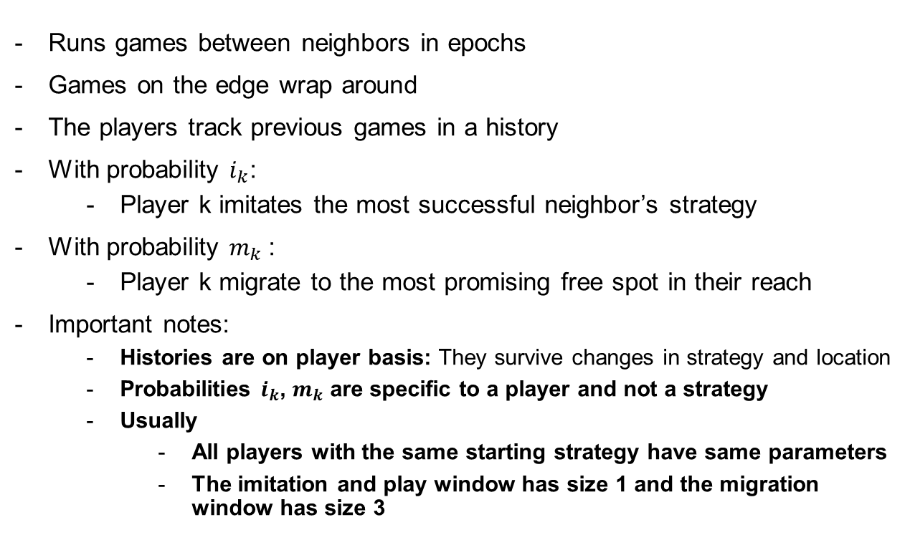
Implementation: Baseline
Runs games between neighbors in epochs
Games on the edge wrap around
The players track previous games in a history
With probability $i_{k}$:
Player k imitates the most successful neighbor’s strategy
With probability $m_{k}$:
Player k migrate to the most promising free spot in their reach
Important notes:
Histories are on player basis: They survive changes in strategy and location
Probabilities $i_{k}$, $m_{k}$ are specific to a player and not a strategy
Usually
All players with the same starting strategy have same parameters
The imitation and play window has size 1 and the migration window has size 3
Play / Imitation Window
Migration Window

Slide 7


Implementation: RPD vs IPD
Repeated
Infinite
An epoch contains one game between the neighbour pairs
Strategies can use the history to influence their plays
Payoffs calculated using a payoff matrix
An epoch epoch represents the outcome of infinite games between neighbors
No real concept of history - the history doesn’t influence decisions in games
Payoffs are directly calculated using the formulas of the strategies
Discount $ω$on player basis
cooperate
defect
(R,R)
(S,T)
$$u\left(s_{0},s_{1}\right)=\sum_{i=0}^{∞}{ω^{i}}⋅r(s_{0_{i}}, s_{1_{i}})$$
cooperate
(T,S)
(P,P)
defect
Nash equilibrium

Slide 8
Implementation: Interfaces
Dash: the dash webinterface allows direct adjustments on all parameters and directly displays the results while the simulation is running. This enables quick interaction with the simulation.
Console app: allows the execution of many large experiments. All results are saved as files and can be inspected as soon as the experiment finished running. Config files allow quick design of multiple experiments.
(start pptx for animation)

Slide 9
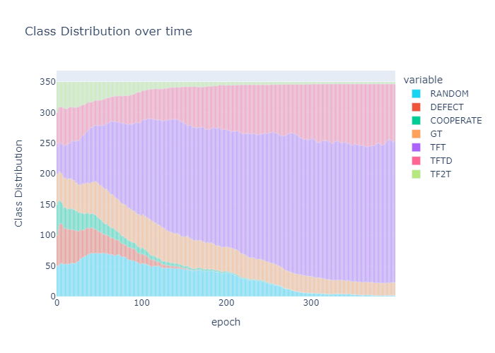
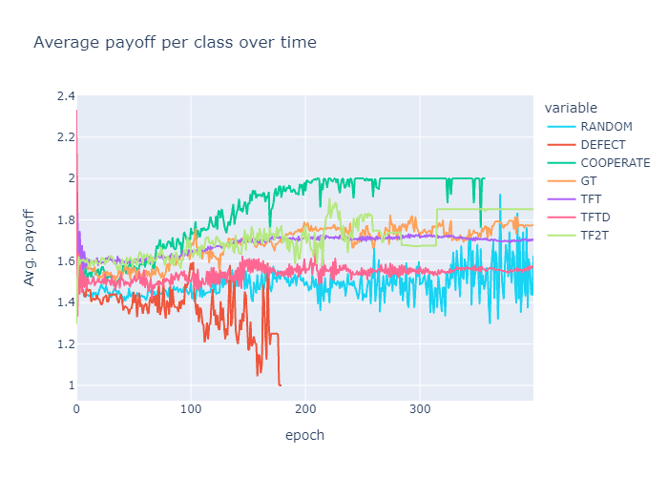
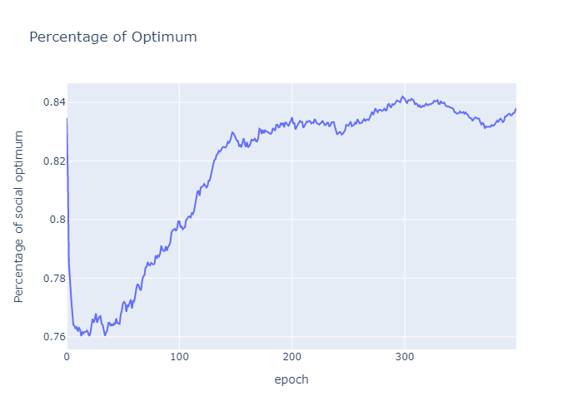
Implementation: Statistics
We compute the following statistics in our simulations:
Class distribution over time
Avg. class payoff over time
Percentage of Optimum
achieved payoff this round
full cooperation payoff
Values are averaged over k runs. The maximum variance for each value is computed alongside (can be found in the experiment folder)

Slide 10
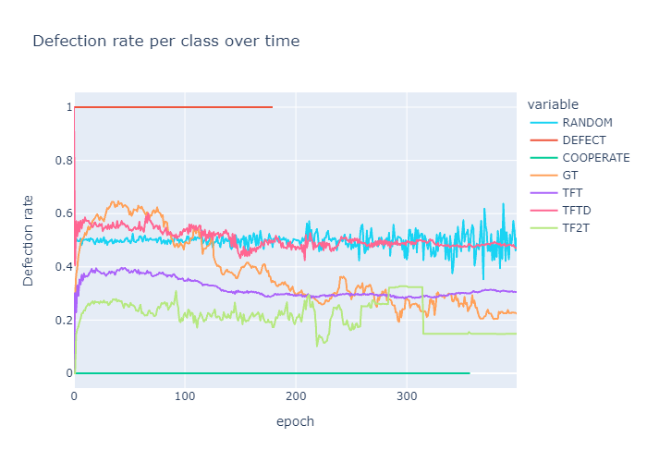
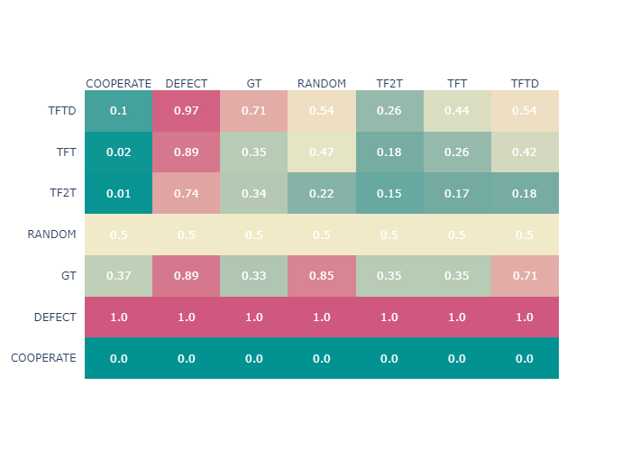
Implementation: Statistics
We compute the following statistics in our simulations
Defection rate per class
How often a class defects against every other class (left against top)
In case a line ends we know that this strategy died out
We can see how TFT has a defection rate > 0 against TFT.
This is a result of histories being between players and not between strategies
E.g., a former defect player switched to TFT and meets a TFT player against which he previously defected. The other player will now defect based on their shared history.

Slide 11
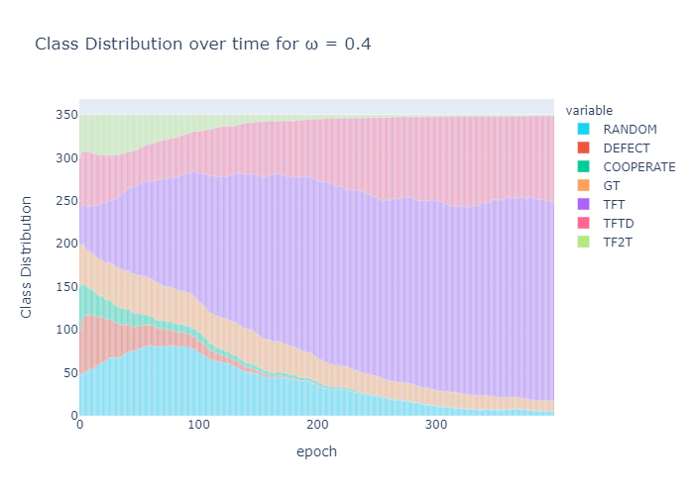
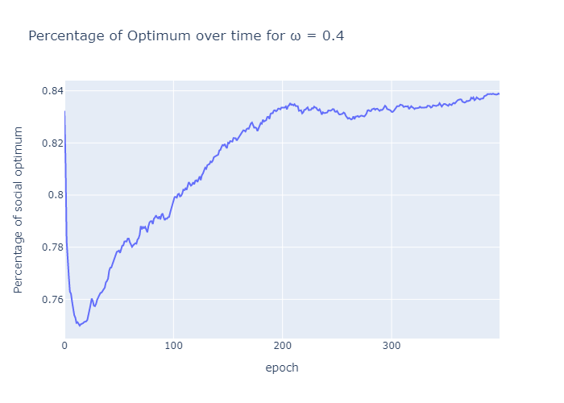
Results: Dominating strategy in a base case
Base case:
Experiment with 50 of each RANDOM, DEFECT, COOPERATE, GT, TFT, TF2T, TFTD on 20 x 20 grid
Migration- & Imitation-probability are set to 10%
Payout matrix:
-> TFT was the most popular and successful strategy
-> it “dominates” the others
 | C | D
C | 20,20 | 1,30
D | 30,1 | 10,10

Slide 12
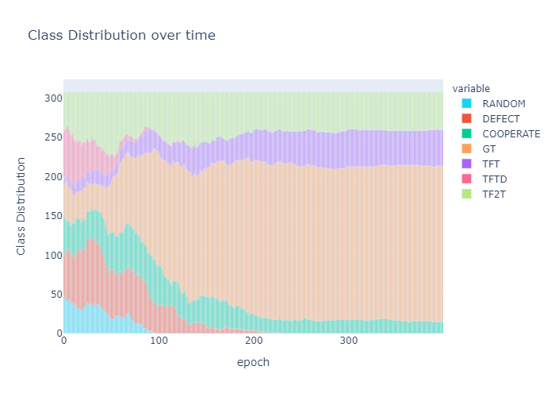
Results: Reducing TFT starting player-count to offset domination
TFT starting player count was continuously reduced from the base case 50 to 5 (other hyperparameters as base case)
As expected with less starting players the strategy dominated less frequently:
20 players → Still ~50% the dominating strategy (10 players -> ~25% of games)
At 8 players the strategy died out as often as it dominated (~20% of games)
<8 players TFT died out very frequently which could be attributed to ‘’unlucky spawns’’
TFT needs only 25 starting-players (7.14% of player base) to dominate 80% of games.
Where TFT did not dominate Grimm Trigger and TFT-variants were chosen by the most players.

Slide 13
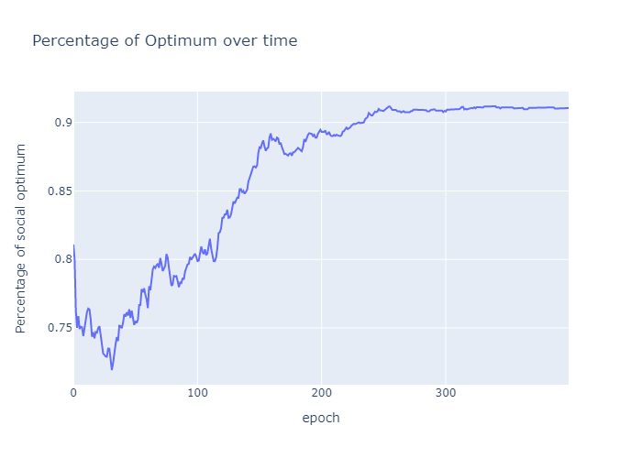
Results: Grimm Trigger “runner-up” and Nash equilibrium emergence
In 80% of cases, players playing Grim Trigger and one of the TFT-Variants fell into a Nash equilibrium where they have nothing to gain by imitating other players or migrating to another spot on the grid.
Percentage of optimum was on average 7% higher. This means in cases where the TFT-starting population was reduced, the game moved closer to the social optimum, even without changing anything about non-friendly strategies.

Slide 14
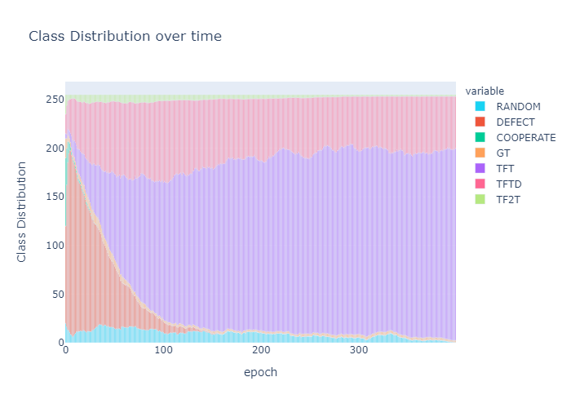
Results: Impact of imitation-probability in a DEFECT-dense playspace
Games with even distribution showed expected acceleration of equilibrium development for higher imitation and migration probabilities.
In games where there were a great number of players starting with the DEFECT strategy, imitation probability decisively changed which strategy was most successful and most played.
TFT (despite starting again with a decreased population) gained popularity and success from low to mid (10-50%) imitation rates with it dominating between 30-70%.
Note: (The hyperparameters for this experiment are more complex than for the ones before. Please consult the paper for a complete breakdown.)

Slide 15
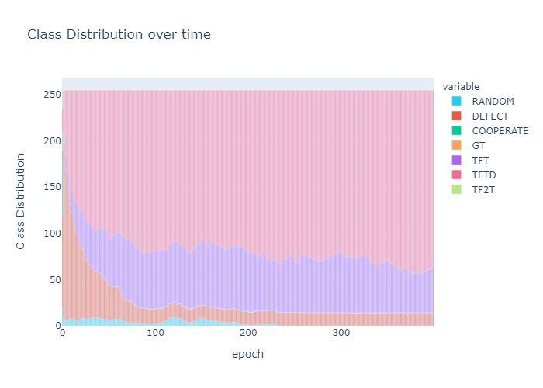
Results: Impact of imitation-probability in a DEFECT-dense playspace
TFT success grows smaller between 50% and 70% imitation probability.
In very high imitation playspaces (>70%) suspicious Tit-For-Tat (TFTD) proved to be the dominating strategy. (as seen in the figure here for 90%)
This could be a result of TFTD starting with more players and TFT not being significantly better than TFTD after the starting-phase of the game -> there is no late-game incentive to switch from TFTD to TFT.
Note: (The hyperparameters for this experiment are more complex than for the ones before. Please consult the paper for a complete breakdown.)

Slide 16
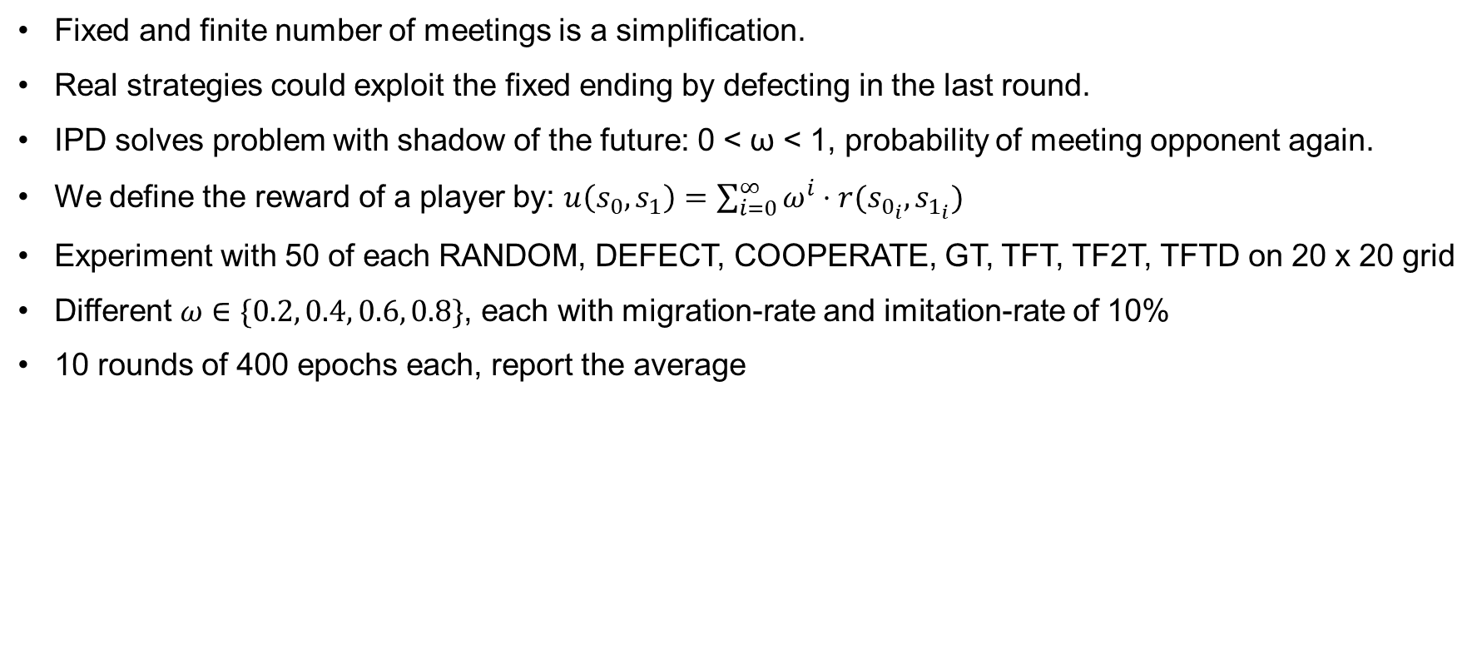
Infinite Spatial Prisoners Dilemma with success-driven migration and imitation (IPD)
Fixed and finite number of meetings is a simplification.
Real strategies could exploit the fixed ending by defecting in the last round.
IPD solves problem with shadow of the future: 0 < ω < 1, probability of meeting opponent again.
We define the reward of a player by: $u\left(s_{0},s_{1}\right)=\sum_{i=0}^{∞}{ω^{i}}⋅r(s_{0_{i}}, s_{1_{i}})$
Experiment with 50 of each RANDOM, DEFECT, COOPERATE, GT, TFT, TF2T, TFTD on 20 x 20 grid
Different $ω∈\{0.2, 0.4, 0.6, 0.8\}$, each with migration-rate and imitation-rate of 10%
10 rounds of 400 epochs each, report the average
 | C | D
C | 20,20 | 1,30
D | 30,1 | 10,10

Slide 17
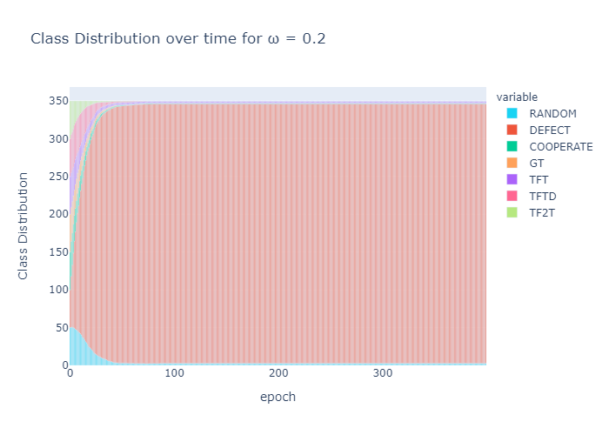
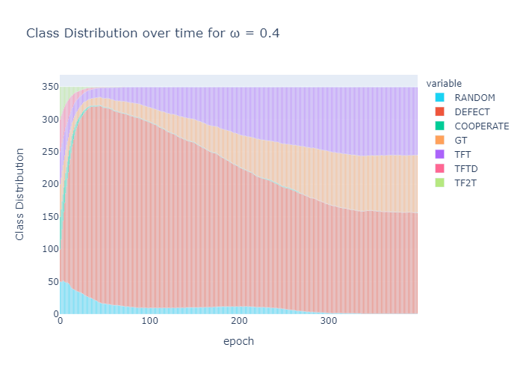
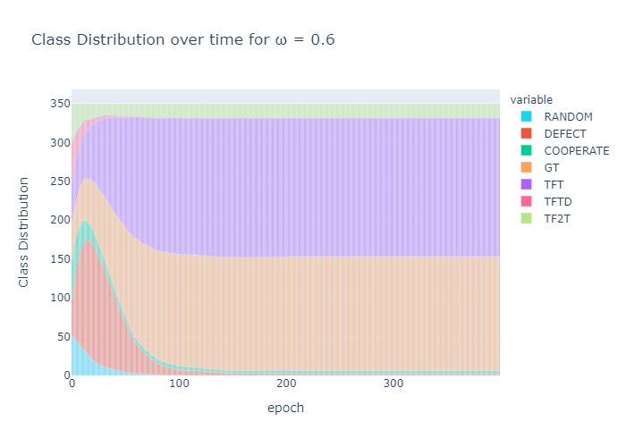
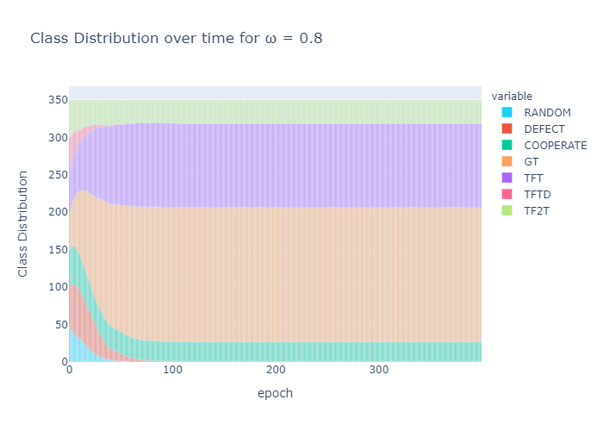
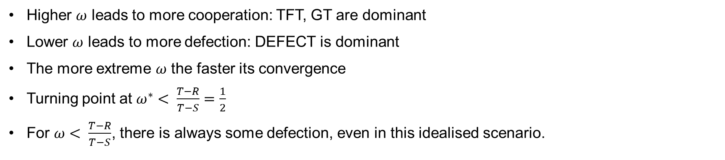
Extension: Infinite Spatial Prisoners Dilemma with success-driven migration and imitation (IPD)
Higher $ω$ leads to more cooperation: TFT, GT are dominant
Lower $ω$ leads to more defection: DEFECT is dominant
The more extreme $ω$ the faster its convergence
Turning point at $ω^{∗}< \frac{T−R}{T−S}=\frac{1}{2}$
For $ω< \frac{T−R}{T−S}$, there is always some defection, even in this idealised scenario.

Slide 18
Future Work
During our experiments we found several interesting experiments that one could try out with none or slight modifications to our simulator
K-Step RPD: Let players play k rounds of the PD before we allow imitation and migration (bridges to IPD but allows to keep history)
Threshold Imitation & Migration: Players only imitate or migrate when their new strategy / location is better than the current one by some threshold
Switch Imitation and Migration Order
Allow abstention: Building on the work of Perc et al. in our setting
Simulate Harsh environments: Introduces survival
Simulate a shared common good against one can always defect
Extend strategy set

Slide 19
Robin Staab
Kim Nik Baumgartner
Fabrice Egger
Jan Urech
Nando Käslin
ETH Zurich
staabr@student.ethz.ch, ETH Zurich
kimbau@student.ethz.ch, ETH Zurich
fegger@student.ethz.ch, ETH Zurich
jurech@student.ethz.ch, ETH Zurich
kaeslinn@student.ethz.ch, ETH Zurich

